Slide 1

Cyber Girls 4 . 0 Open Day Project
Automated Phishing Attack Simulation
and
Firewall Testing & Evasion
Group Number 6
Names: 1. Tetuh Wibinah
2. Audrey Isutsa
3. Florence Kabona
4. Praise A. Utibe
5. Ivy Owusu

Slide 2

Introduction
Overview:
The digital landscape faces increasing threats from cyberattacks, particularly phishing attacks and firewall evasion techniques.
Objective:
To simulate phishing attacks using Bash scripts and test the effectiveness of firewalls while identifying potential evasion techniques.

Slide 3

Tool Used:
Zphisher because of its capability to create fake and dummy websites such as PayPal, google, Netflix.
Process:
1. Installation of Zphisher and setup.
2. Creating a phishing link.
3. Embedding the phishing link into an email using a Bash script.
Phishing
Simulation Attack

Slide 4
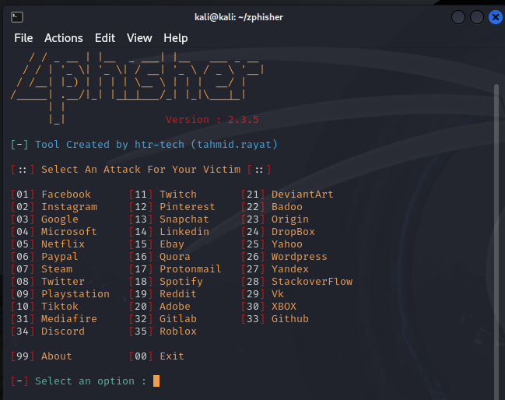
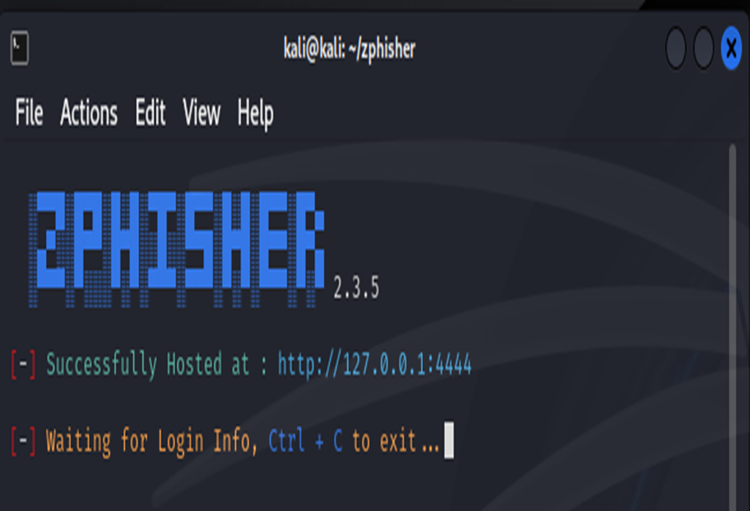
Zphisher Screenshots
The attached show the zphisher tool and the phishing link to attach on the email body.
http://127.0.0.1:4444

Slide 5
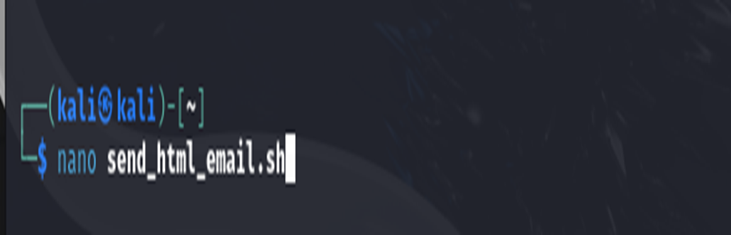
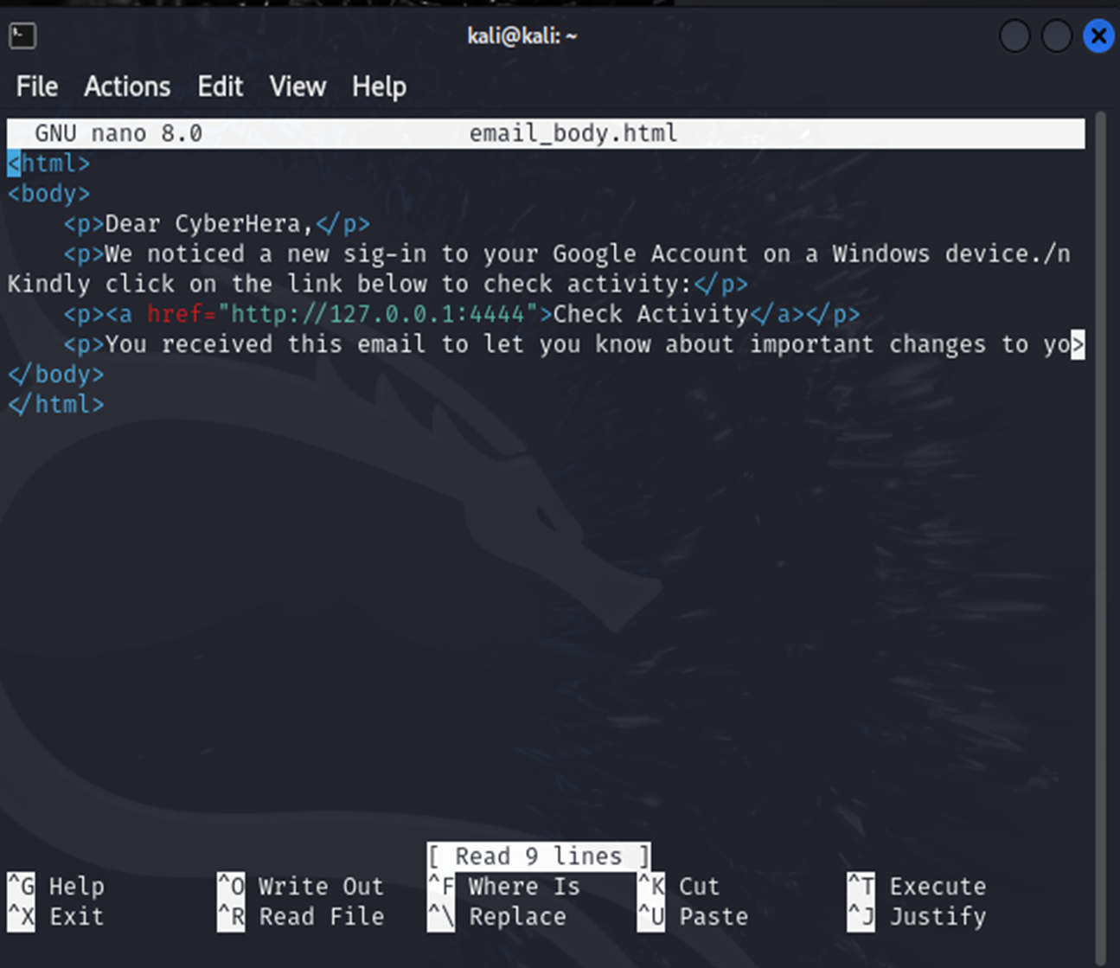
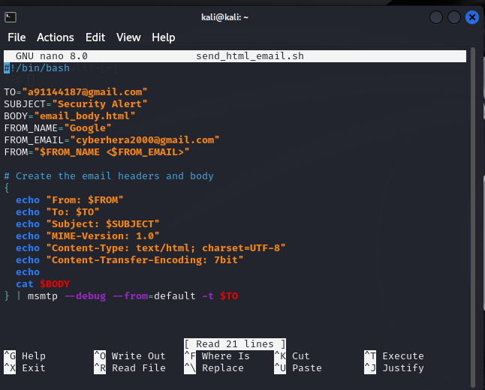
Email Screenshots

Slide 6
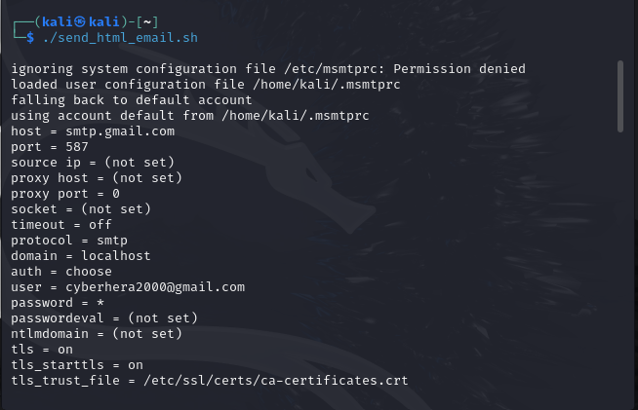
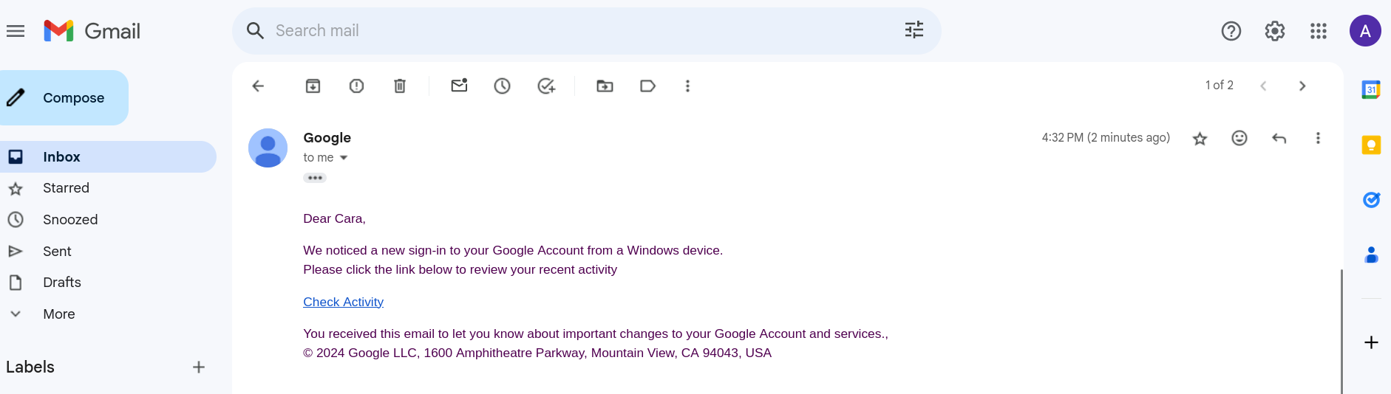
Email Screenshot
Run the script to send the mail ./send_html_email.sh
This is Proof that the target received the email. Once user clicks on the link, they will be re-directed to the cloned Google page where the user will log into their account.

Slide 7
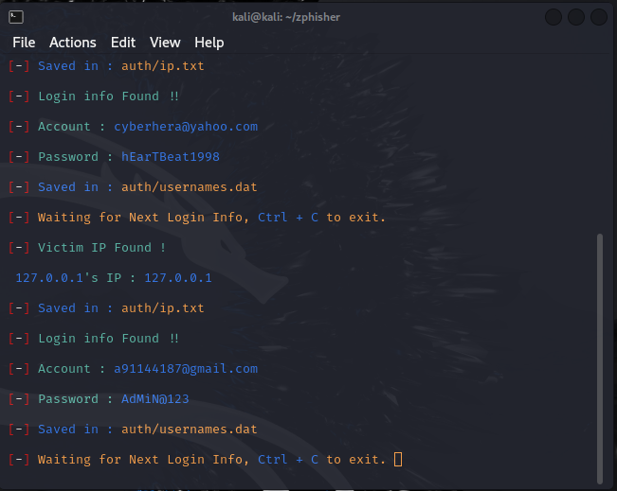
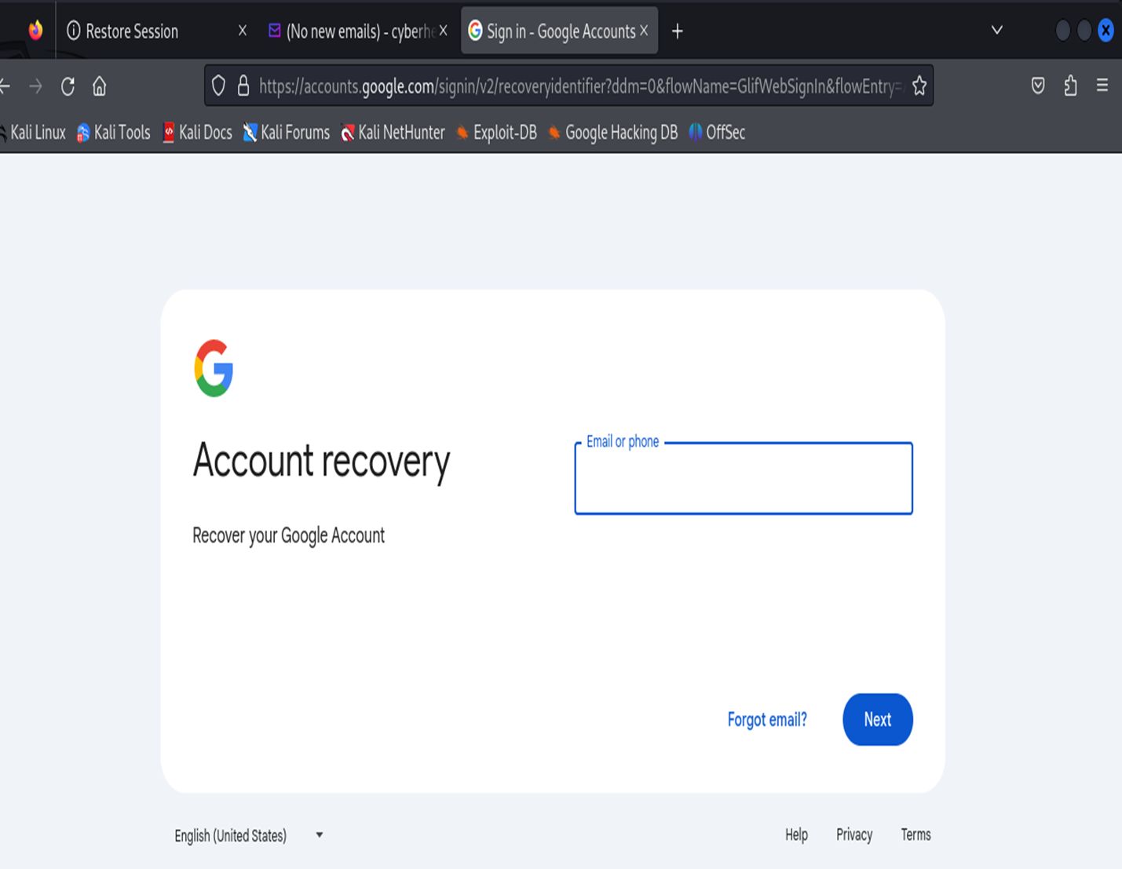
Credentials Screenshot
After the user types in login information and sign in, they will be re-directed to a genuine google page for account recovery whereas, zphisher captures the login details.

Slide 8
Technique:
Bypassing firewall rules using SSH tunneling.
Installed an uncomplicated Firewall, as it is designed for ease to use.
It features a command-line interface with a limited set of straightforward commands and utilizes iptables for configuration.
Process:
An attacker uses an allowed port (e.g., HTTP) to access services on a blocked port (e.g., FTP).
Impact:
Demonstrates how attackers can exploit firewall weaknesses.
Firewall
Testing & Evasion

Slide 9
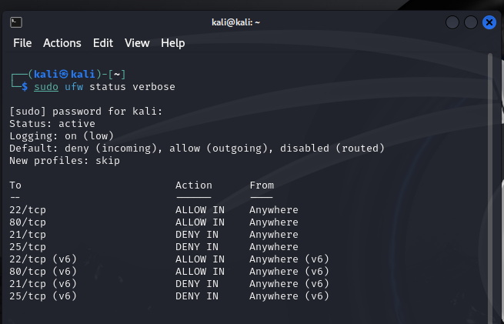
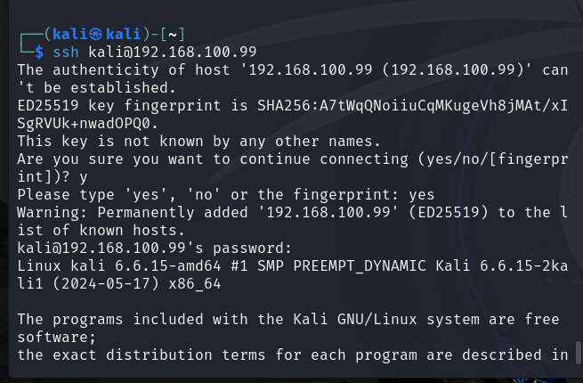
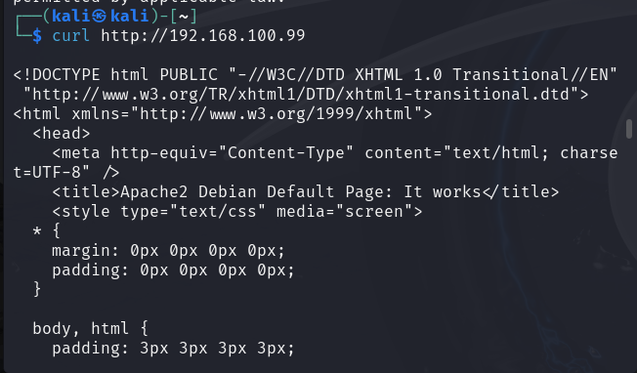
Testing Firewall Rules
Allowed ports and 22 and 80 and denied ports 21 and 25.
When testing both allowed ports, Both ports 22 and 80 are working as expected. Traffic is allowed

Slide 10
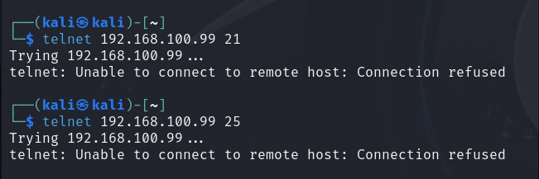
Testing Firewall Continued
Testing the denied ports, 21 and 25. Both connections are denied as shown below.

Slide 11
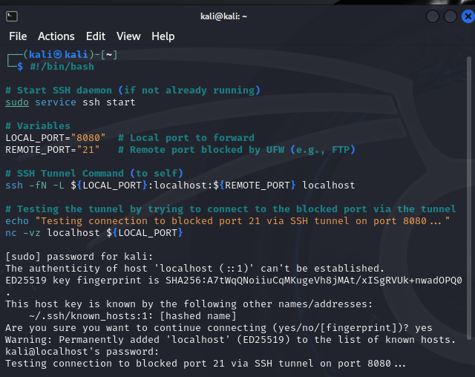
Firewall Evasion
This script below bypasses the UFW rule that blocks port 21 by using an SSH tunnel.
This is a common evasion technique where attackers use allowed ports to access services on blocked ports.

Slide 12
Conclusion
Findings:
1. Phishing attacks are effective and pose significant risks.
2. Firewalls are critical, but they have vulnerabilities that can be exploited.
Project Outcomes:
The project underscored the importance of regular testing and updating of security measures to mitigate these threats.

Slide 13
Recommendations
For Phishing:
1. Conduct regular phishing simulations and user training.
2. Implement robust email filters and two-factor authentication.
For Firewalls:
1. Regularly update firewall rules and software.
2. Implement additional layers of security like IDS/IPS.
3. Monitor traffic for unusual patterns that could indicate evasion.

Slide 14
References
The State of Phishing Attacks" by Verma, S., & Das, A. (2018). Computer Science Review.
Evasion Techniques in Network Security: An Overview" by Wang, Y., & Zhang, Q. (2020). IEEE Communications Surveys & Tutorials.
Official GitHub Repository: https://github.com/htr-tech/zphisher – Documentation and usage instructions.

Slide 15
Thank You

